Slide 1
Big Mountain Ski Resort

Slide 2
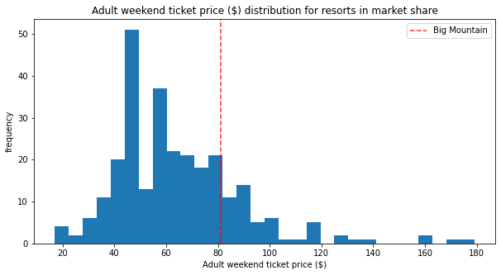
Big Mountain Resort came in right around average in price, because most ticket prices are between $40 and $90, with a peak around $50.
However in Montana, BMR is the only resort over $70.

Slide 3
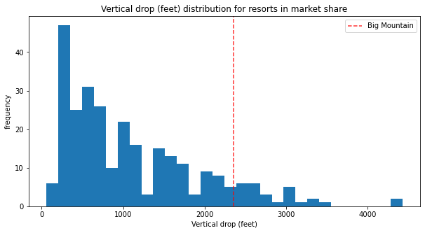
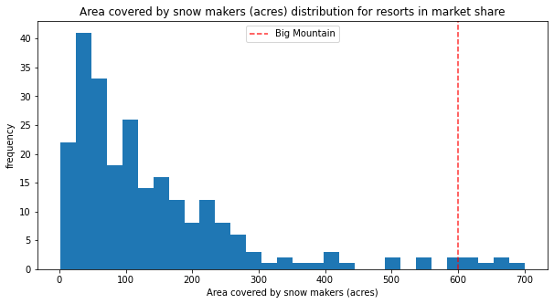
Vertical Drop to the left and Snow Makers below
This coincides with the vertical drop and sno making area aspect where BMR is in the top 10 percent and 5 percent respectfully.

Slide 4
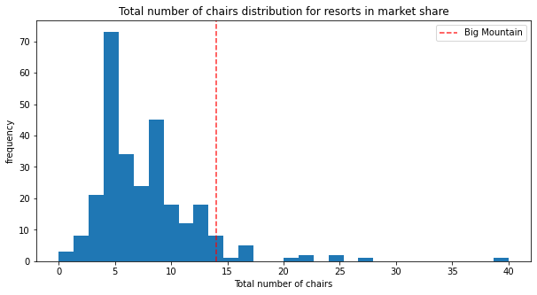
The total number of chairs with ski lifts, BMR is again in the top 5% in the nation

Slide 5
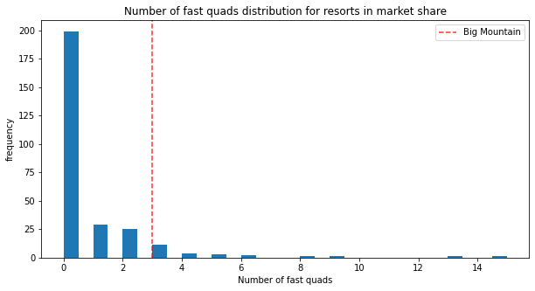
Again, BMR has among the most quads in the nation, where as most don’t even have a single quad.

Slide 6
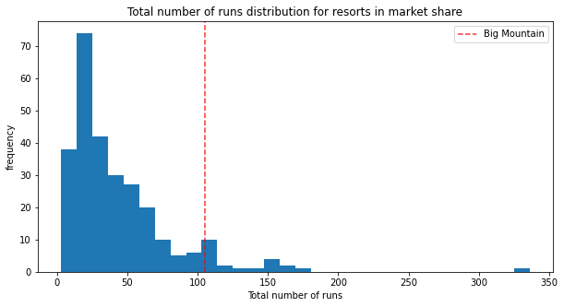
As far as number of runs to ski on, BMR is again in the top 10% in the nation with over 100, where as nearly every other resort has less than 50.

Slide 7
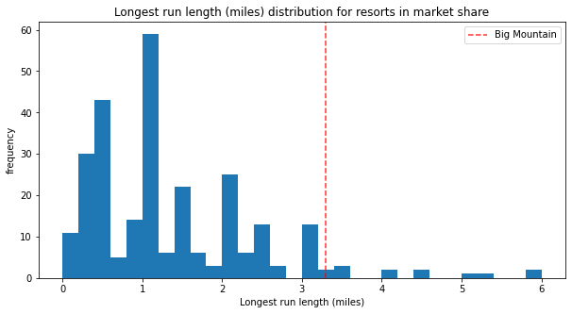
Out of the longest runs in the nation, BMR is right up there with the top 10 resorts in the nation

Slide 8
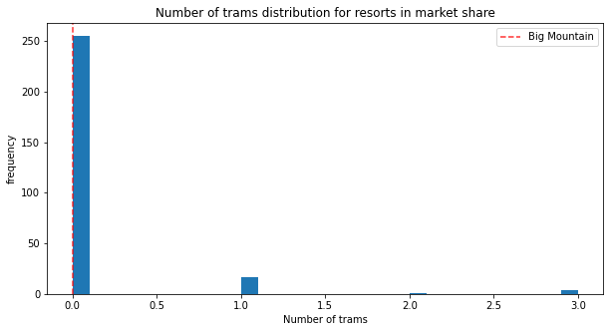
Though it doesn’t have any trams, there are only a handful of resorts that do. Not having a tram is the norm.

Slide 9
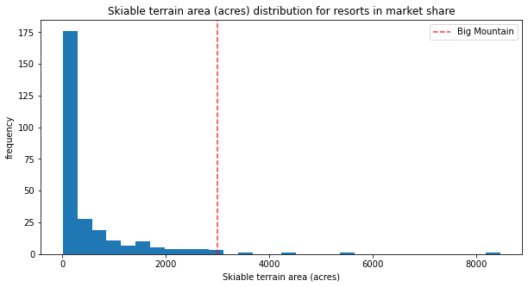
Skiable terrain, again, 75% of resorts have less than 1500 acres where as BMR has over 3000 and is amont the highest in the united states!

Slide 10
With all that being said, the demand Big Mountain Resort features deserve not just the modest $80 they’re asking, but a $20 spike in prices would still be a fair asking price.
Not only does Big Mountain Resort lead the top 10% in nearly every feature, but asking for a $20 increase per ticket would keep them out of the top 10% in prices yet, since the areas in the state are much lower, we wouldn’t want to raise them too much.

